Slide 1
LALA: Learning Object Assembly via Learning to Attend
Presenter: Hao-Yu (Max) Hsu

Slide 2
Overview
Problem Formulation & Motivation
Related Works
Method Design
Dataset Collection
Experimental Results
Conclusion
Future Directions

Slide 3
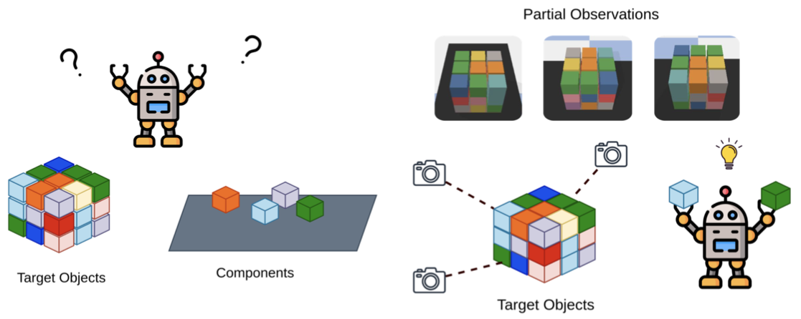
Problem Formulation
Input: multi-view observation from current & target workspace
Output: robot policies (where to pick & where to place)

Slide 4
Related Works
Target-driven Object assembly
Multi-view robot manipulation
Transporter Network

Slide 5
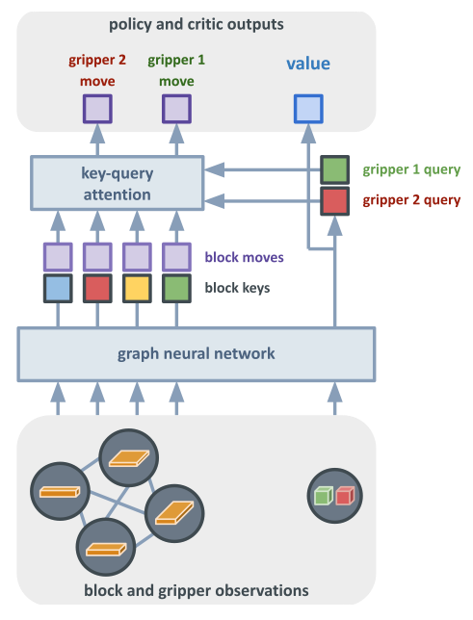
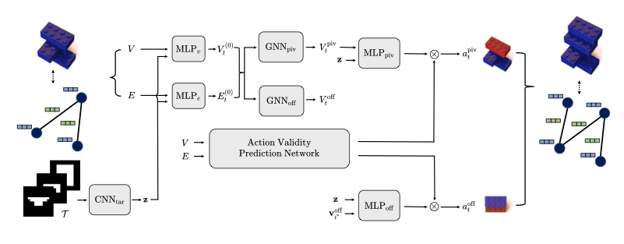
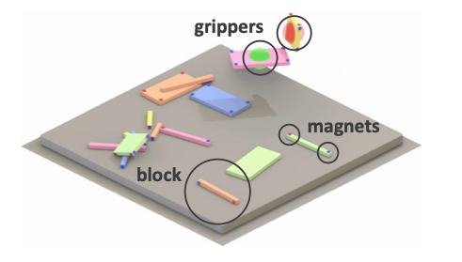
Related Works
Target-driven Object assembly
Generalize to unseen targets
Learn graph-based policies, need GT state from simulator
Brick-by-Brick
Block-Assemble!
Hyunsoo Chung, Jungtaek Kim, Boris Knyazev, Jinhwi Lee, Graham W. Taylor, Jaesik Park, and Minsu Cho. Brick-by-brick: Combinatorial construction with deep reinforcement learning, 2021.
Niklas Funk, Georgia Chalvatzaki, Boris Belousov, and Jan Peters. Learn2assemble with structured representa- tions and search for robotic architectural construction. CoRL, 2021.
Seyed Kamyar Seyed Ghasemipour, Daniel Freeman, By- ron David, Shixiang Shane Gu, Satoshi Kataoka, and Igor Mordatch. Blocks assemble! learning to assemble with large-scale structured reinforcement learning. ICML, 2022.
Richard Li, Allan Jabri, Trevor Darrell, and Pulkit Agrawal. Towards practical multi-object manipulation using relational reinforcement learning, 2020.
Yixin Lin, Austin S. Wang, Eric Undersander, and Ak- shara Rai. Efficient and interpretable robot manipulation with graph neural networks. ICRA, 2022.

Slide 6
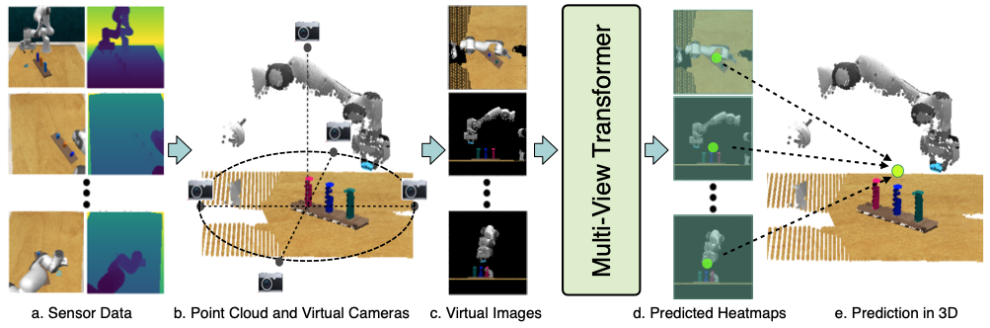
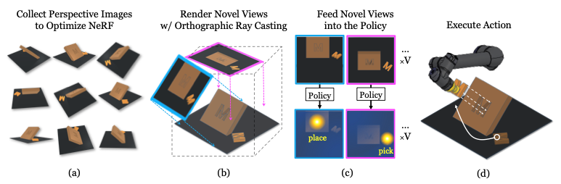
Related Works
Multi-view robot manipulation
Multi-view observation, avoid occlusion & allow more robust policy
Do not have visual target
RVT
MIRA
Lin Yen-Chen, Pete Florence, Andy Zeng, Jonathan T. Barron, Yilun Du, Wei-Chiu Ma, Anthony Simeonov, Alberto Rodriguez Garcia, and Phillip Isola. MIRA: Mental imagery for robotic affordances. In Conference on Robot Learning (CoRL), 2022.
Ankit Goyal, Jie Xu, Yijie Guo, Valts Blukis, Yu-Wei Chao, and Dieter Fox. Rvt: Robotic view transformer for 3d object manipulation. CoRL, 2023.

Slide 7
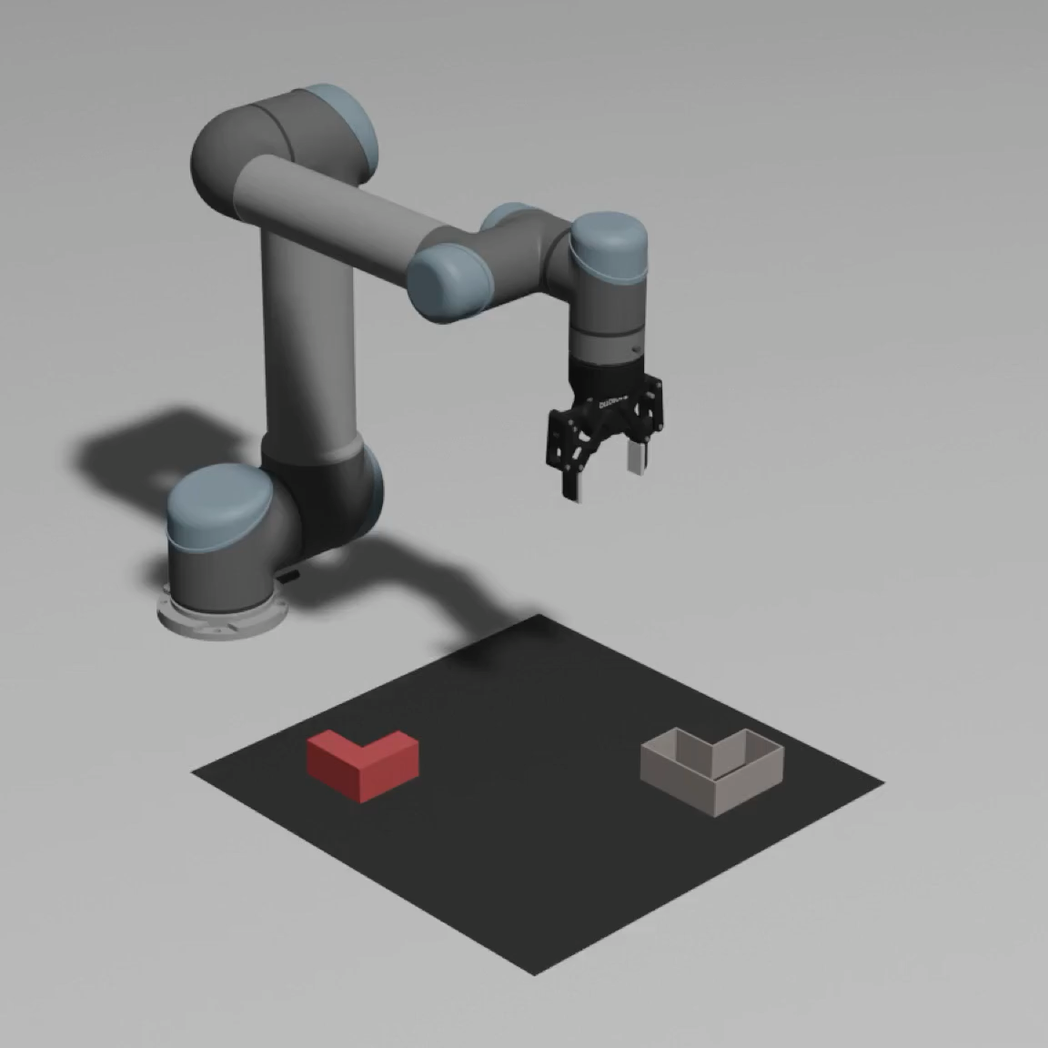
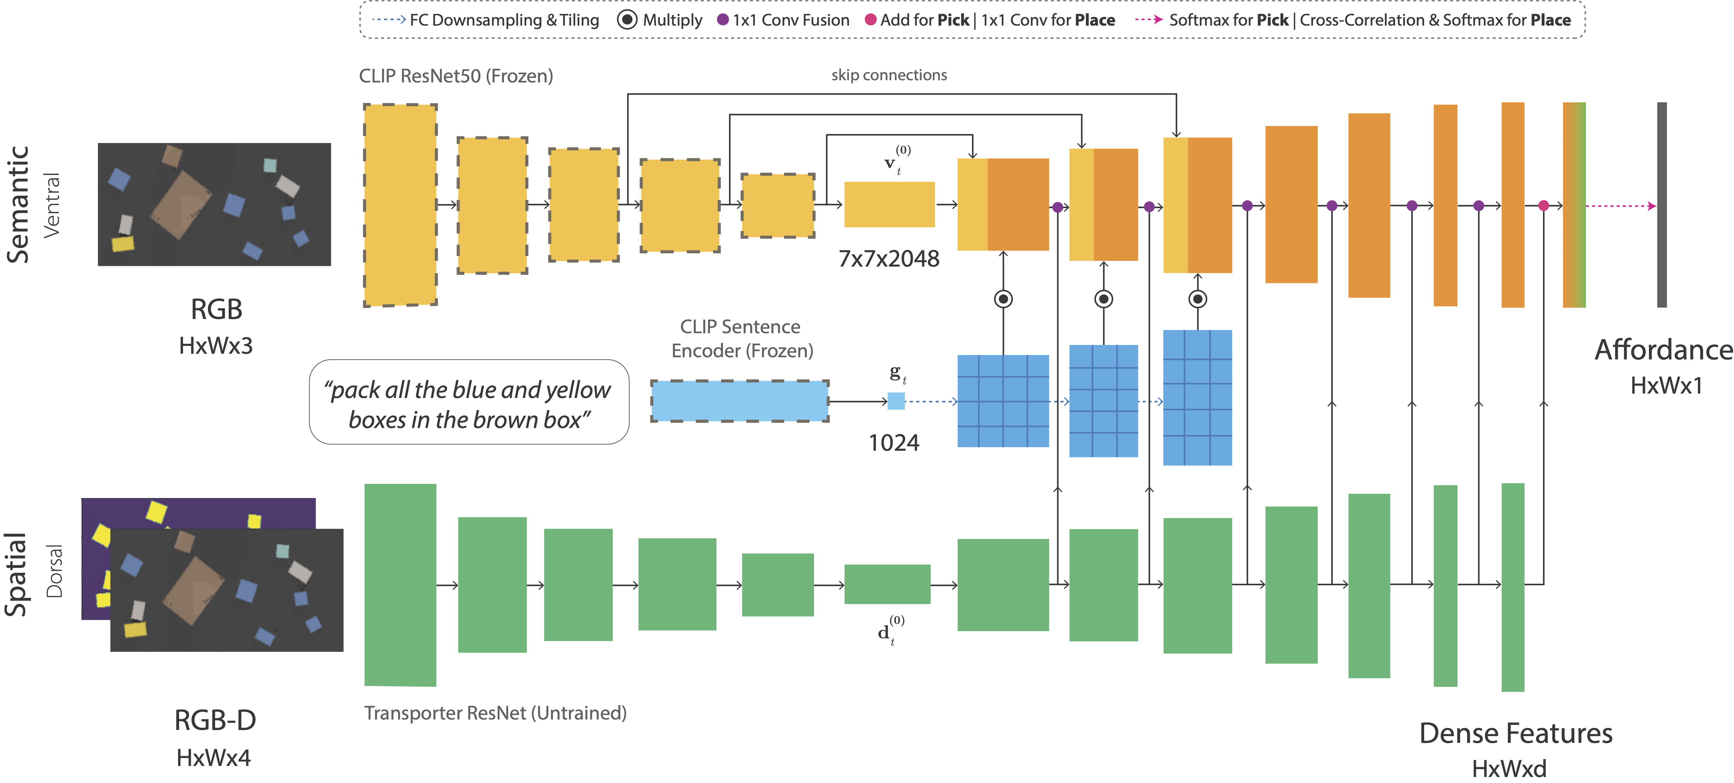
Related Works
Transporter Network
Top-down affordance map, provide spatial precision
Can not observe stacked objects, need multi-view visual input
Transporter Network
CLIPort
Andy Zeng, Pete Florence, Jonathan Tompson, Stefan Welker, Jonathan Chien, Maria Attarian, Travis Arm- strong, Ivan Krasin, Dan Duong, Ayzaan Wahid, Vikas Sindhwani, and Johnny Lee. Transporter networks: Rearranging the visual world for robotic manipulation, 2020.
Shridhar, Mohit and Manuelli, Lucas and Fox, Dieter. “CLIPort: What and Where Pathways for Robotic Manipulation.” CoRL 2021.

Slide 8
Motivation
Multi-view Target-driven Object Assembly by Robot Manipulation
Without step-by-step guideline in either language or visual manuals

Slide 9
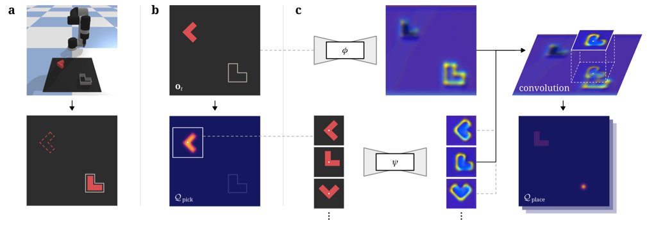
Method Design - Transporter
All three planning networks are the same (ResNet).
Place network (Key)
Pick network (Attention)
Place network (Query)

Slide 10
Method Design - Multi-view Target-driven Transporter
Fuse multi-view features into top-down orthographic feature maps.
Add target observation as network inputs.
Single-stream
Two-stream
Two-stream with lateral connections

Slide 11

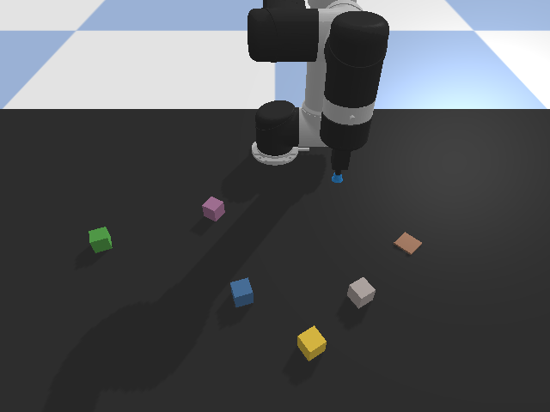
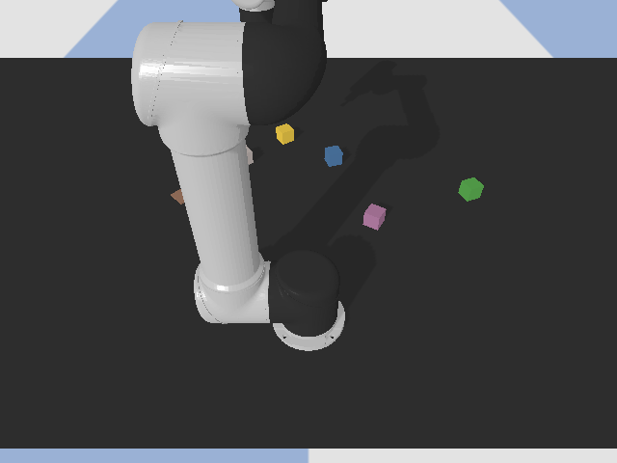
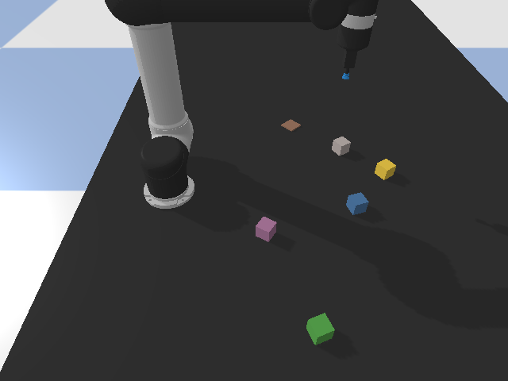
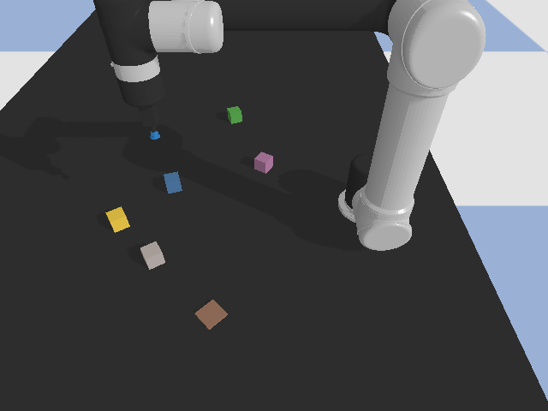
Method Design - Multi-view Target-driven Transporter
Fuse multi-view features into top-down orthographic feature maps.
“Both RGB & feature maps are back-projected.”

Slide 12
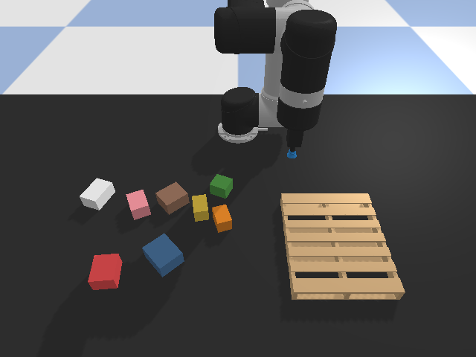

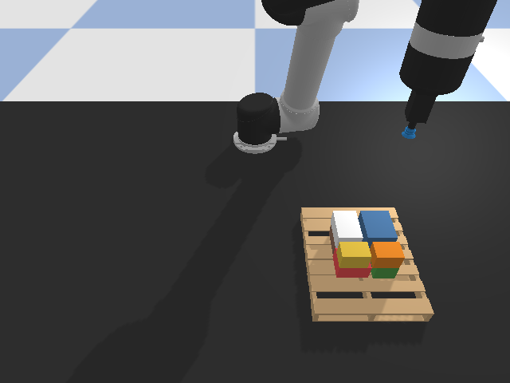
Method Design - Multi-view Target-driven Transporter
Add target observation as planning network inputs.
Single-stream
Two-stream
Two-stream with lateral connections
Two-stream
Single-stream
Two-stream-lat

Slide 13
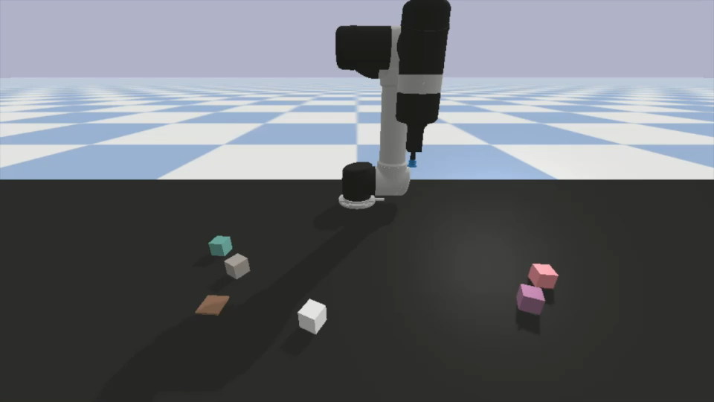
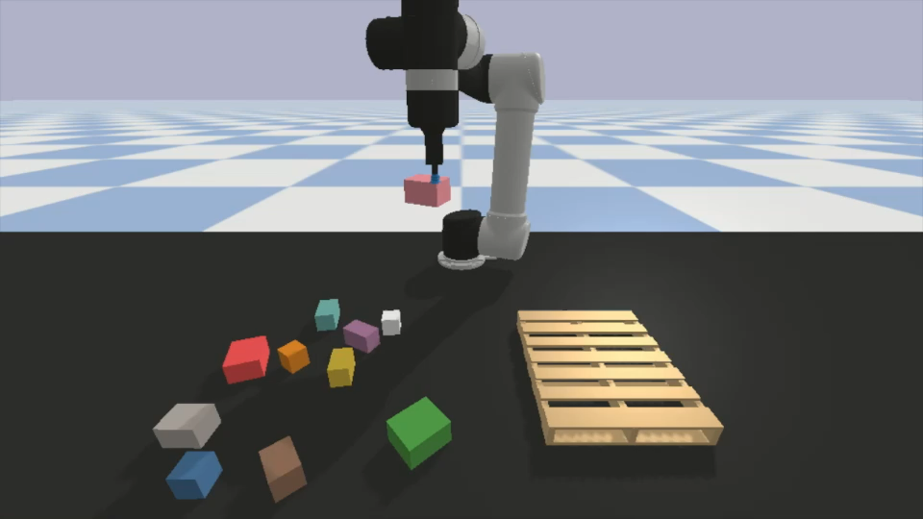
Dataset Collections
Robot simulation environment adapt from CLIPort.
Two customized tasks:
Stack-towers
Stack-blocks
Stack-towers
Stack-blocks

Slide 14
Experimental Results
Method | Stack-Towers | Stack-Boxes
CLIPort | 0.270 | x
Single-stream | 0.134 | 0.060
Two-stream | 0.158 | 0.063
Two-stream lateral connections | 0.000 | 0.000
Table 1. Comparison of mean reward on two custom tasks.
Notes:
Transporter: 1000 demonstrations, train with 40K iterations
CLIPort: 1000 demonstrations, train with 200K iterations
Ours: 500 demonstrations, train with 115 * 500 = 57.5K iterations for CLIPort, 55 * 500 = 27.5K iterations for our method
Network too complex.
The next block to pick could have multiple option.

Slide 15
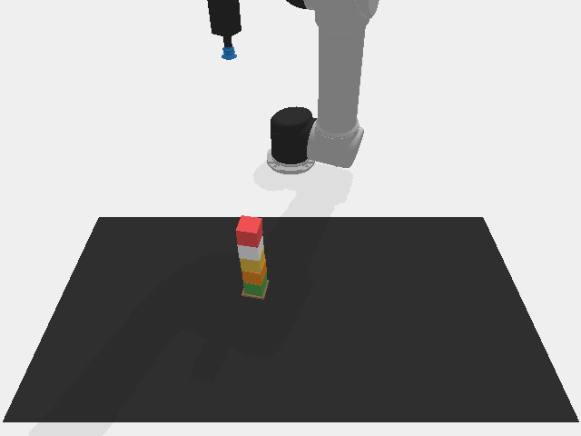
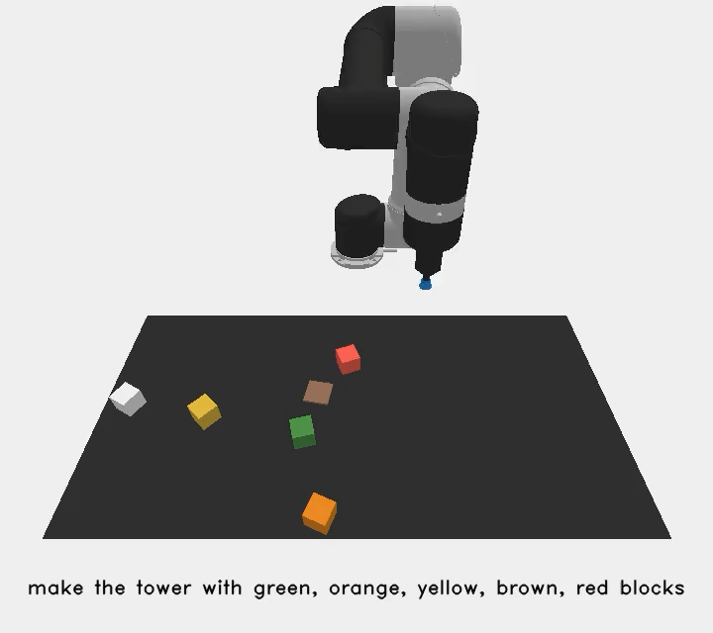
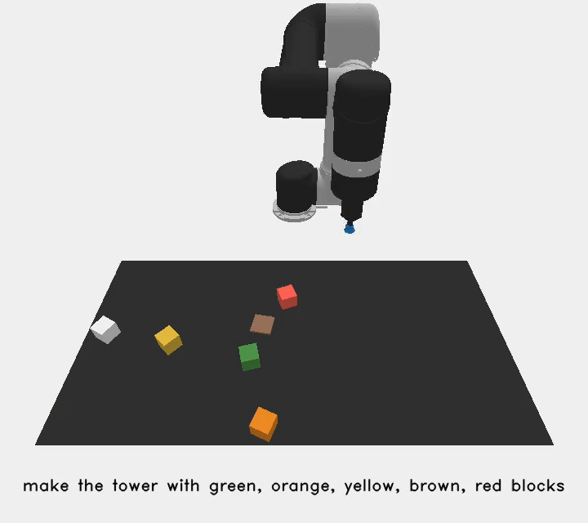
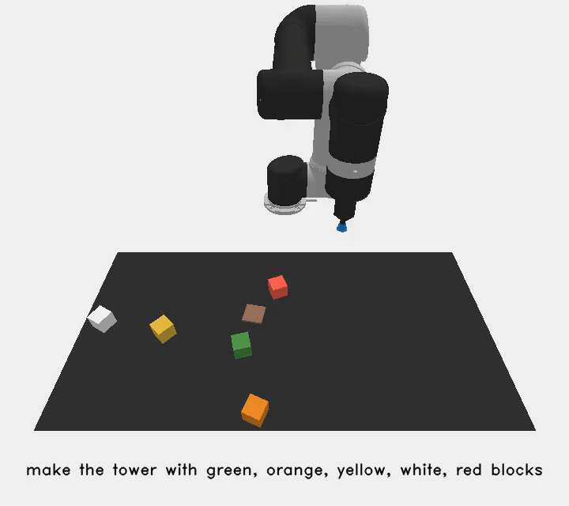

Experimental Results – Stack-Towers
“Make the tower with green, orange, yellow, brown, red blocks.”
CLIPort
Single-stream
Two-stream
Two-stream-lat

Slide 16
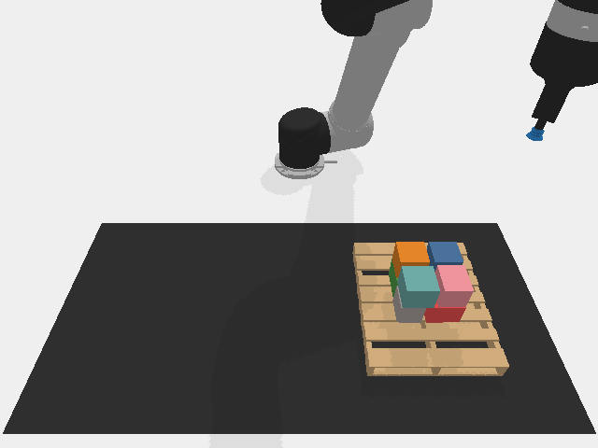
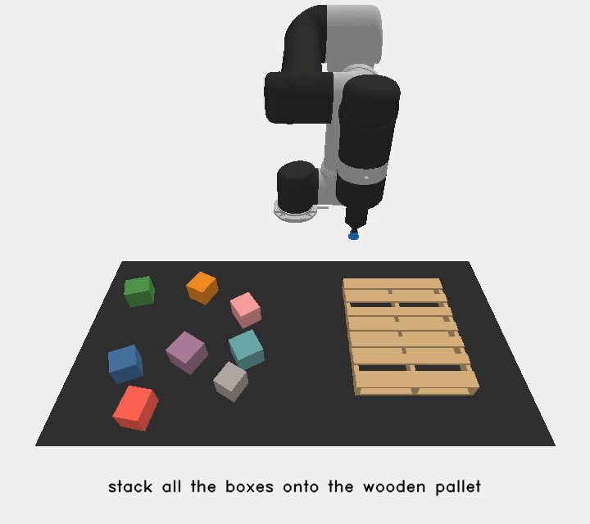


Experimental Results – Stack-Boxes
”Stack all the boxes onto the wooden pallet.”
Single-stream
Two-stream
Two-stream-lat

Slide 17
Conclusion
Propose a method on multi-view target-driven object assembly task
Create two custom object stacking tasks (stack towers & stack boxes)

Slide 18
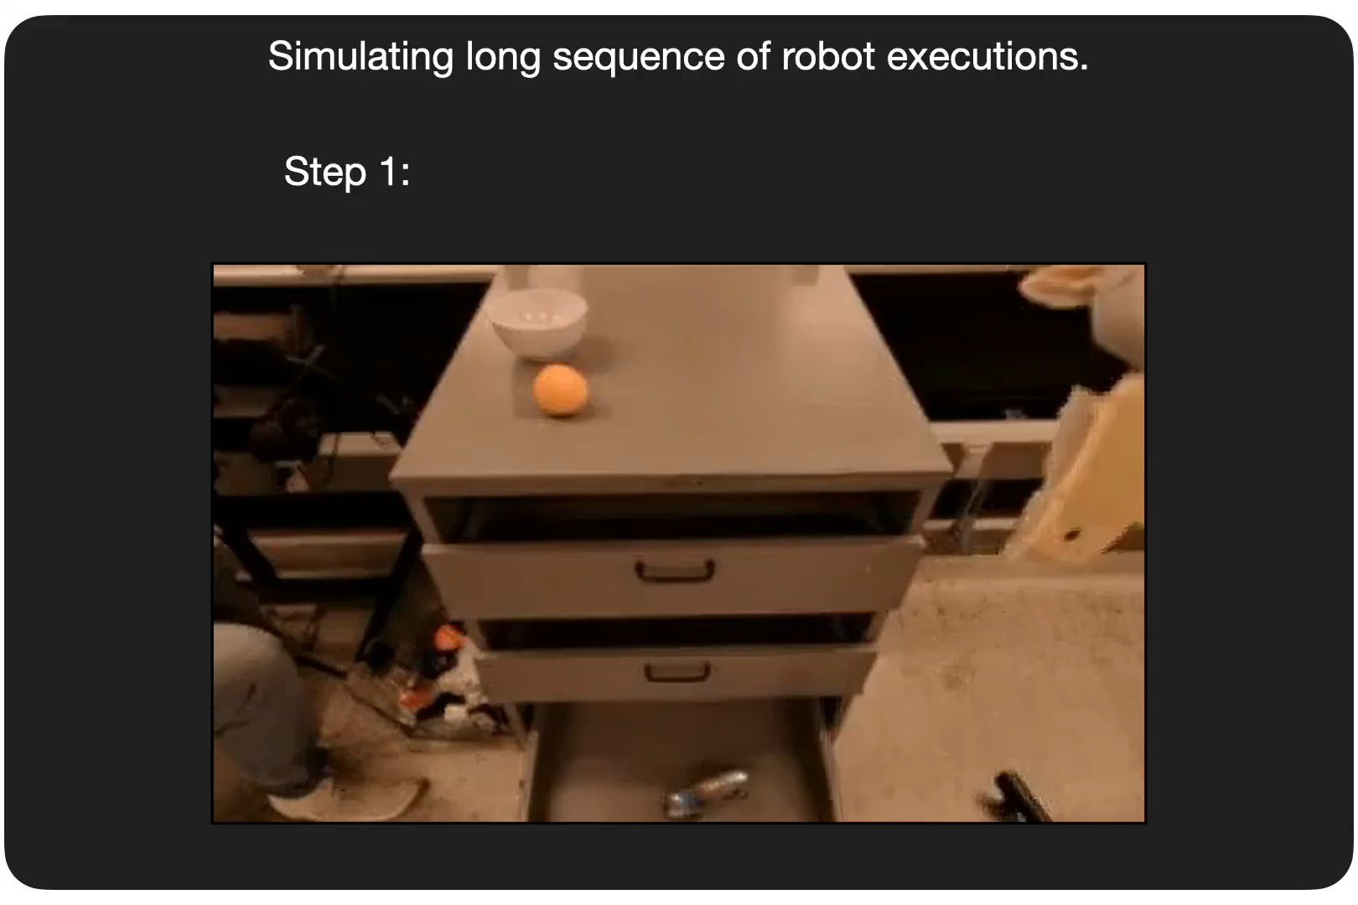
Future Directions
Adapt RVT framework (attend from local patches across multiple views)
Simulate rollouts of object assembly process
RVT
UniSim
Ankit Goyal, Jie Xu, Yijie Guo, Valts Blukis, Yu-Wei Chao, and Dieter Fox. Rvt: Robotic view transformer for 3d object manipulation. CoRL, 2023.
Yang, Mengjiao and Du, Yilun and Ghasemipour, Kamyar and Tompson, Jonathan and Schuurmans, Dale and Abbeel, Pieter. “Learning Interactive Real-World Simulators”. Arxiv 2023.

